Slide 1
COURSE NAME: COURSE CODE:
ARTIFICIAL INTELLIGENCE
CIS 412
SYED TANGIM PASHA
LECTURER,
DEPARTMENT OF COMPUTING AND INFORMATION SYSTEM (CIS)
DAFFODIL INTERNATIONAL UNIVERSITY (DIU)
DHAKA,BANGLADESH

Slide 2
ARTIFICIAL INTELLIGENCE
Artificial Intelligence: Artificial Intelligence (AI), the ability of a digital computer or computer-controlled robot to perform tasks commonly associated with intelligent beings. The term is frequently applied to the project of developing systems endowed with the intellectual processes characteristic of humans, such as the ability to reason, discover meaning, generalize, or learn from past experience.
Intelligence: Intelligence has been defined in many ways: the capacity for abstraction, logic, understanding, self-awareness, learning, emotional knowledge, reasoning, planning, creativity, critical thinking, and problem-solving.
Learning: Learning is the process of acquiring new understanding, knowledge, behaviors, skills, values, attitudes, and preferences.

Slide 3
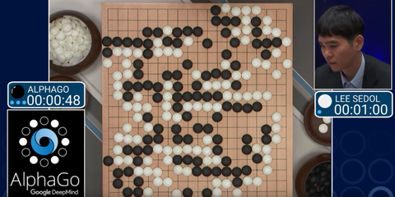
ARTIFICIAL INTELLIGENCE
AlphaGo: AlphaGo is a computer program that plays the board game Go. It was developed by DeepMind Technologies a subsidiary of Google.

Slide 4
JUST VIDEOS FOR LEARNING MORE
https://www.youtube.com/watch?v=eiqUzieHu8o (FAIR)
https://www.youtube.com/watch?v=gg7WjuFs8F4 (Google DeepMind Research on Bioinformatics)
https://www.youtube.com/watch?v=Fn589zeMij4 (Turing Award Winners for Neural Network)
https://www.youtube.com/watch?v=8tq1C8spV_g (Alpha Go Trailer)
https://www.youtube.com/watch?v=WXuK6gekU1Y&t=424s (Alpha Go Movie)
https://www.youtube.com/watch?v=_luhn7TLfWU (MIT Cheetah)
https://www.youtube.com/watch?v=tF4DML7FIWk (Atlas- Boston Dynamics)

Slide 5
ARTIFICIAL INTELLIGENCE
Self Driving Cars (https://www.youtube.com/watch?v=taMP_n3wL7M)
Google Maps
Text Autocorrect (Grammerly)
Automated Translation (Google Translator)
Chatbot (Alexa-Amazon)
Social Media (Facebook, Instagram, Twitter)
Face Detection and Recognition (https://www.youtube.com/watch?v=agGEDdj05U0)
Robots (https://www.youtube.com/watch?v=IPukuYb9xWw)
Natural Language Processing (NLP) ()
Computer Vision (CV)

Slide 6
ARTIFICIAL INTELLIGENCE
3 Types of Artificial Intelligence
Artificial narrow intelligence refers to AI systems that can only perform a specific task autonomously using human-like capabilities. These machines can do nothing more than what they are programmed to do, and thus have a very limited or narrow range of competencies.
Artificial General Intelligence is the ability of an AI agent to learn, perceive, understand, and function completely like a human being. These systems will be able to independently build multiple competencies and form connections and generalizations across domains, massively cutting down on time needed for training.
Super AI surpasses human intelligence and can perform any task better than a human. it also evokes emotions, needs, beliefs, and desires of its own. Its existence is still hypothetical. Some of the critical characteristics of super AI include thinking, solving puzzles, making judgments, and decisions on its own.

Slide 7
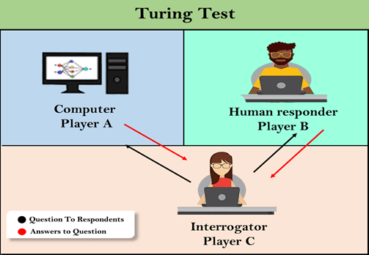
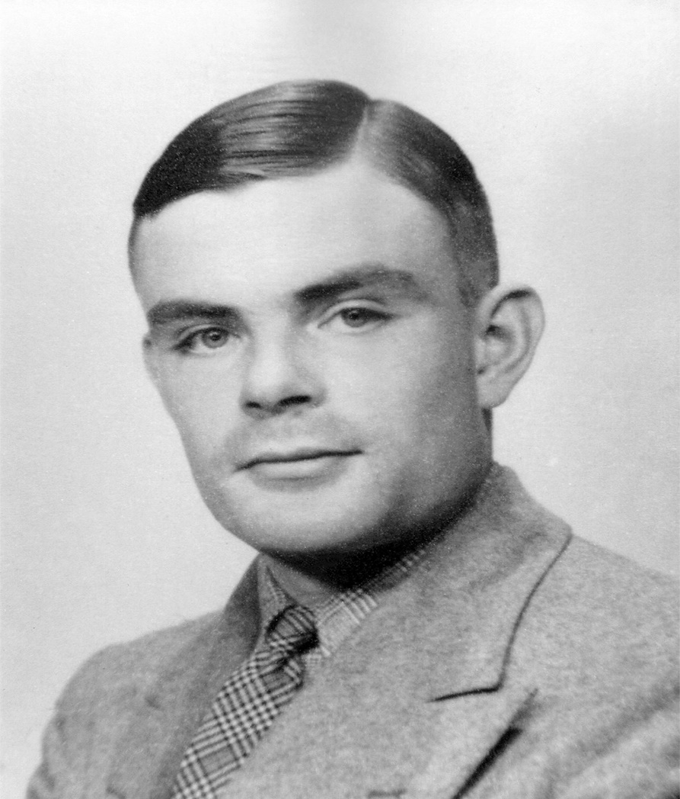
ARTIFICIAL INTELLIGENCE

Slide 8
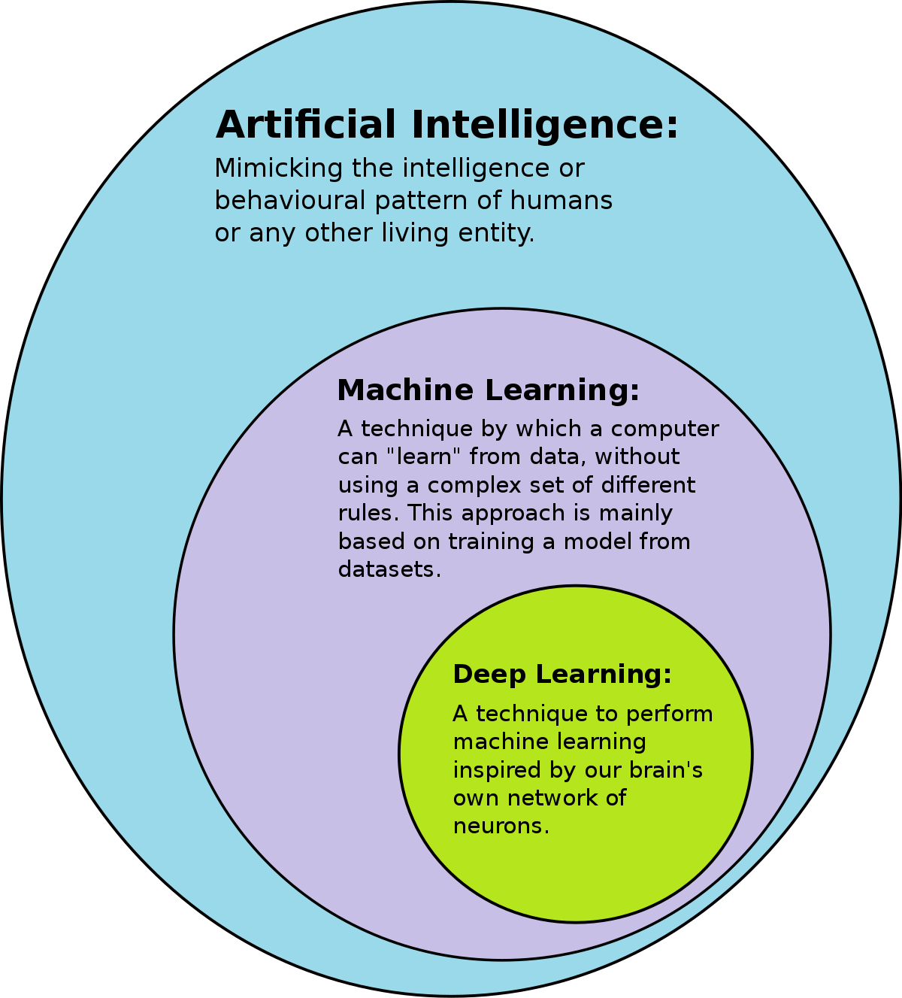
WHAT IS AI, ML, DL?

Slide 9
DATA SCIENCE and DATA MINING
Data Science: Data Science is an interdisciplinary field that uses scientific methods, processes, algorithms and systems to extract knowledge and insights from noisy, structured and unstructured data, and apply knowledge from data across a broad range of application domains.
Data Mining: Data Mining is the process of extracting and discovering patterns in large data sets involving methods at the intersection of machine learning, statistics and database systems.
Data Mining is an interdisciplinary subfield of computer science and statistics with an overall goal of extracting information from a data set and transforming the information into a comprehensive structure for further use.

Slide 10
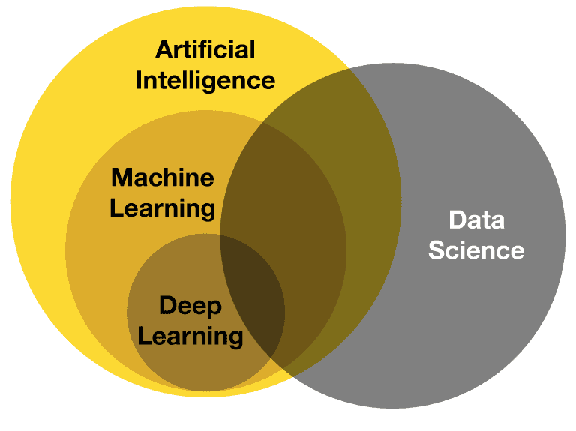
AI vs DATA SCIENCE vs ML vs DL

Slide 11
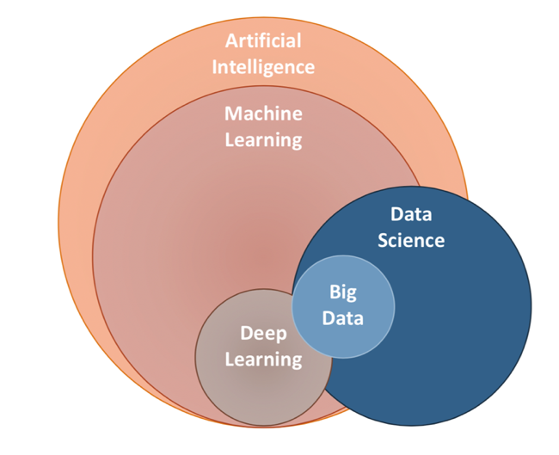
AI vs ML vs DL vs DATA SCIENCE vs BIG DATA

Slide 12
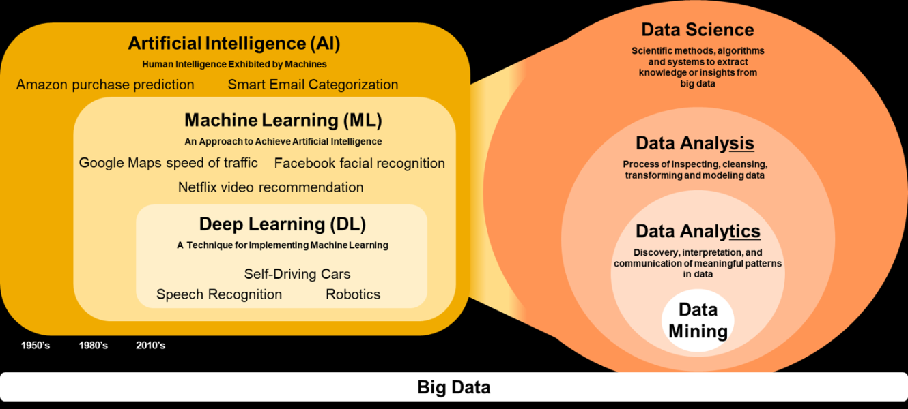
AI vs DATA SCIENCE vs ML vs DL vs DATA MINING

